Slide 1

WATER QUALITY ANALYSIS
DONE BY :
U19CN142
MOTUPALLY SRIKARACHARYA
COMPUTER SCIENCE DEPARTMENT
GUIDED BY :
Mrs. V.VIDHYA, M.E
ASSISTANT PROFESSOR

Slide 2
OUTLINE
OBJECTIVE
ABSTRACT
LITERATURE SURVEY
EXISTING SYSTEM
PROPOSED SYSTEM
MODULES
SYSTEM CONFIGURATION
REFERENCES

Slide 3
OBJECTIVE
Access to safe drinking water is essential to health, a basic human right, and a component of effective policy for health protection.

Slide 4
ABSTRACT
A Regression algorithm is used to assign predefined classes to test instances for evaluation (or) future instances to an application.
This study presents a Regression model using Random Forest Algorithm to analyze water quality.
Water quality is very important in ensuring citizens can get to drink clean water.
Regression using Random Forest was applied to predict the clean and not clean water.
The analysis of water Hardness, solids, Turbidity, pH level, Sulfate, and conductivity can play a major role in assessing water quality.
Nowadays Most Diseases are caused by Using Water To avoid Those diseases We are Implementing This Model

Slide 5
LITERATURE SURVEY
S.NO | TOPIC NAME | ALGORITHM | ADVANTAGES | DISADVANTAGES
1 | WATER QUALITY ANALYSIS USING RANDOM FOREST ALGORITHM | RANDOM FOREST ALGORITHM | USING ENSEMBLE TECHNIQUES IT WILL PREDICT HIGH ACCURACY | IT TAKES SOME TIME TO TEST THE ENSEMBLE TECHNIQUES
2 | WATER PORTABILITY USING DECISION TREE | DECISION TREE | IT TRAINS AND TEST THE HUGE DATA | IT DOES NOT GIVES HIGH ACCURACY

Slide 6
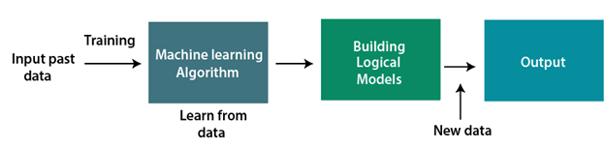
EXISTING SYSTEM
This research was based on unsupervised learning. The significance of this paper was to find new methods for Water Analysis and to increase the accuracy of results.
The accuracy of an algorithm is around 70%. Thus, the accuracy of the results obtained from these methods is less when compared with the proposed system.
A comprehensive understanding of the quality of a water sample can be helpful for us to solve the problem of Water Quality Analysis.
The work provides a comprehensive discussion of the challenges and problems of water.

Slide 7
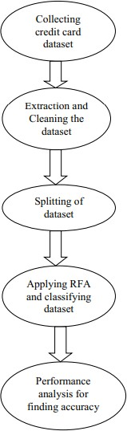
PROPOSED SYSTEM
In the proposed system, we use RFA for the classification and regression of the dataset. First, we will collect the Water Quality dataset and analysis will be done on the collected dataset.
After the analysis of the dataset then cleaning of the dataset is required. Generally, in any dataset there will be many duplicates and null values will be present, so to remove all those duplicates and null values cleaning process is required.
DISADVANTAGES
It takes so much time to run the data set.
Decision tree has low accuracy.
Data has more null values.

Slide 8
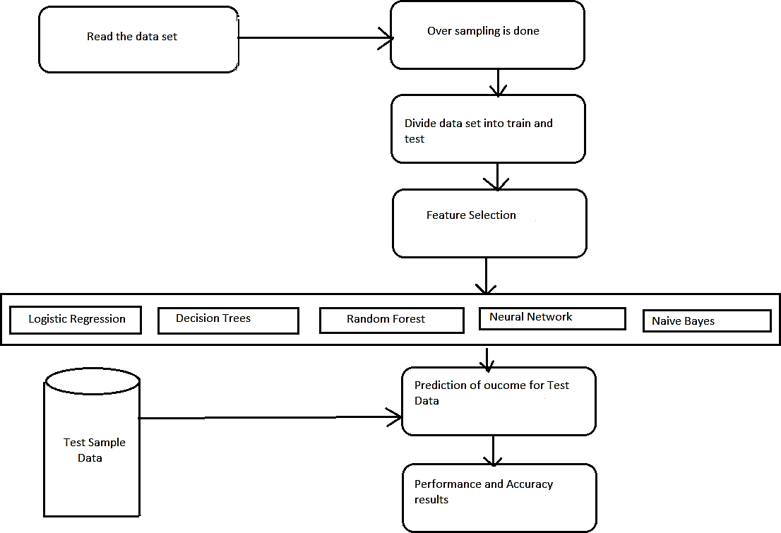
ARCHITECTURE DIAGRAM

Slide 9
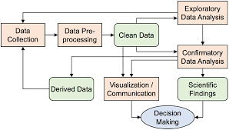
MODULES
MODULE NAME: EXPLORATORY DATA ANALYSIS
Exploratory Data Analysis In this module we will first collect all the Water Quality analysis dataset and store it in a database. Then we will perform some descriptive analysis of the dataset.

Slide 10
MODULE NAME: DATA CLEANING
Data Cleaning Is the next step, after analyzing the dataset then we have to clean the data. In this cleaning process, all the duplicate values and null values that are present in the dataset will be removed and moved to further process.

Slide 11
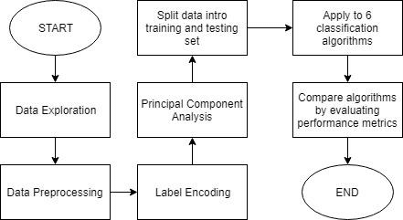
MODULE NAME: DATA PREPROCESSING
Preprocessing of dataset In this module, the cleaned dataset will be preprocessed where the dataset will be divided based on Given Data.

Slide 12
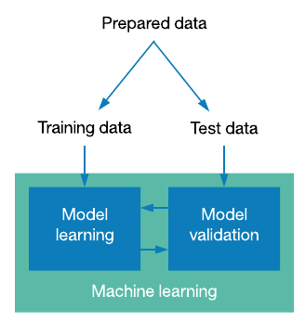
MODULE NAME: SPLITTING OF DATA
Dataset Partition In this module first the dataset will be divided into two partitions a trained dataset and a testing dataset. After the data partitions, the Random Forest Algorithm is applied. After applying RFA finally, a confusion matrix is obtained.

Slide 13
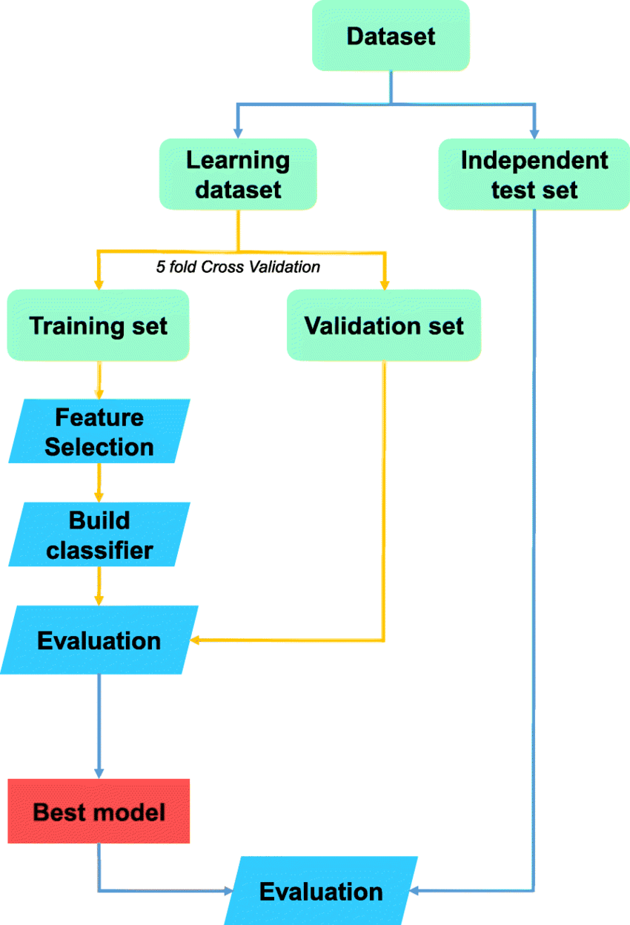
MODULE NAME: PREDICTING THE ACCURACY
Evaluation Now the resultant data obtained in the form of a confusion matrix can be evaluated by using graphical representation which gives better accuracy .

Slide 14
SYSTEM CONFIGURATION
SOFTWARE REQUIREMENTS
PROGRAMMING LANGUAGE: PYTHON
IDE: GOOGLE COLAB
TECHNOLOGIES USED: MACHINE LEARNING
HARDWARE REQUIREMENTS
Processor - i5-10th Gen
Speed - 1.6 GHz
RAM - 8 GB
Hard Disk - 512 GB

Slide 15
REFERENCES
1. Jiang, J.; Tang, S.; Han, D.; Fu, G.; Solomatin, D.; Zheng, Y. A comprehensive review on the design and optimization of surface water quality monitoring networks. Environ. Model. Soft. 2020, 132, 104792.
2. Zhou, Y.; Yu, D.; Yang, Q.; Pan, S.; Gai, Y.; Cheng, W.; Liu, X.; Tang, S. Variations of Water Transparency and Impact Factors in the Bohai and Yellow Seas from Satellite Observations. Remote Sens. 2021, 13, 514.
3.Mateo Pérez, V.; Mesa Fernández, J.M.; Villanueva Balsera, J.; Alonso Álvarez, C. A Random Forest Model for the Prediction of FOG Content in Inlet Wastewater from Urban WWTPs. Water 2021, 13, 1237.
4. Zhou, Z.H. Ensemble learning. In Machine Learning; Springer: Berlin/Heidelberg, Germany, 2021; pp. 181–210
5. Karami, J.; Alimohammadi, A.; Seifouri, T. Water quality analysis using a variable consistency dominance-based rough set approach. Comput. Environ. Urban Syst. 2014, 43, 25–33.

Slide 16
THANK YOU

